Slide 1
NON-WSQ COURSE • C817
Gemini for Google Sheet
Version v2.0 · 19 October 2026
Tertiary Infotech Academy Pte Ltd
UEN: 201200696W
www.tertiarycourses.com.sg | enquiry@tertiaryinfotech.com | +65 6100 0613
© Tertiary Infotech Academy Pte Ltd

Slide 2
COURSE ADMINISTRATION
Welcome & Housekeeping
© Tertiary Infotech Academy Pte Ltd
Gemini for Google Sheet (C817) · C817
1

Slide 3







INTRODUCTION
About the Trainer
PhD-qualified trainer specialising in AI, data and software engineering.
Builds AI agents and Gemini and Google Workspace workflows for business teams.
Dr. Alfred Ang
Trains professionals across Singapore on practical, project-based AI skills.
AI Trainer & Engineer
Certifications: PMP, AWS, Microsoft, CompTIA, CKA, CKAD.
linkedin.com/in/angchewhoe
github.com/alfredang
© Tertiary Infotech Academy Pte Ltd
Gemini for Google Sheet (C817) · C817
2

Slide 4
ICE-BREAKER
Let's Know Each Other
Your name, organisation and role.
One spreadsheet you rebuild or clean every week or month.
1
2
A formula, chart or report you wish someone would just build for you.
Whether you can see the Ask Gemini (spark) button in Google Sheets on your account.
3
4
© Tertiary Infotech Academy Pte Ltd
Gemini for Google Sheet (C817) · C817
3

Slide 5
HOUSEKEEPING
Ground Rules
Set your mobile phone to silent mode.
Participate actively — no question is too small.
1
2
Mutual respect: agree to disagree.
One conversation at a time.
3
4
Be punctual; return from breaks on time.
Learn by doing — try every hands-on lab.
5
6
© Tertiary Infotech Academy Pte Ltd
Gemini for Google Sheet (C817) · C817
4

Slide 6
COURSE MATERIALS
Access Course Materials
1
2
3
4
5
▶
▶
▶
▶
Open the C817 course page or the trainer-supplied Drive folder
Open the courseware links for this course
Download the Slides, Learner Guide and Lesson Plan
Open the labs folder for all 12 lab folders
Keep the files together as you work
Course page: tertiarycourses.com.sg/gemini-for-google-sheet.html
© Tertiary Infotech Academy Pte Ltd
Gemini for Google Sheet (C817) · C817
5

Slide 7
SCHEDULE
Lesson Plan — 1 Day, 7.5 instructional hours
Course sequence
Day format
• Topic 1: Fundamentals of Google Sheet (Labs 1–4)
• Topic 2: Data Analytics and Visualization (Labs 5–8)
• Topic 3: Interactive Dashboard (Labs 9–12)
• Daily timing
– 9:30 am - 6:30 pm (1-hour lunch; two 15-minute tea breaks; 7.5 instructional hours)
• Instructional time
– 7.5 hours · 12 connected labs
• Learning arc
– Concept → demonstrate → build → verify → discuss → recap
© Tertiary Infotech Academy Pte Ltd
Gemini for Google Sheet (C817) · C817
6

Slide 8
COURSE ROADMAP
Twelve Labs in Three Topics
Fundamentals of Google Sheet
Data Analytics & Visualization
Interactive Dashboard
• Lab 1: Gemini Side Panel & Summaries
• Lab 2: Data Quality Check
• Lab 3: Data Prep
• Lab 4: Formulas: VLOOKUP, COUNTIF & Nested IF
• Lab 5: Tables, Trackers & Conditional Formatting
• Lab 6: AI Function & Fill with Gemini
• Lab 7: Data Analysis & Insights
• Lab 8: Charts & Visualisation
• Lab 9: Dashboard KPIs & Selectors
• Lab 10: Interactive Dashboard
• Lab 11: Gems
• Lab 12: Optimisation, Reporting & Safe Sharing
© Tertiary Infotech Academy Pte Ltd
Gemini for Google Sheet (C817) · C817
7

Slide 9
WHAT YOU'LL ACHIEVE
Learning Outcomes
Sheets Fundamentals
Use Gemini in Google Sheets - the side panel, actions and formula help - to summarise, quality-check and prepare HR data, and to generate, explain and fix formulas such as VLOOKUP, COUNTIF and nested IF.
Analytics & Visualization
Create colour-coded tables, trackers and dropdowns, extract and categorise text with the AI function, and generate data analysis, insights, pivot tables and charts with Gemini, verifying every result.
1
2
Interactive Dashboard
Build an interactive hiring dashboard, automate repeat screening with a custom Gem, and use Gemini's optimisation solver, reporting and sharing features responsibly.
3
© Tertiary Infotech Academy Pte Ltd
Gemini for Google Sheet (C817) · C817
8

Slide 10
LEARNING APPROACH
How You'll Learn
1
2
3
4
5
▶
▶
▶
▶
Trainer demonstrates the concept
You build it yourself in the hands-on lab
Verify with the lab's 'Test it' step
Discuss and troubleshoot together
Recap against the learning outcomes
© Tertiary Infotech Academy Pte Ltd
Gemini for Google Sheet (C817) · C817
9

Slide 11
CORE CONCEPTS
Gemini in Google Sheets for HR and Recruitment
© Tertiary Infotech Academy Pte Ltd
Gemini for Google Sheet (C817) · C817
10

Slide 12
OVERVIEW
The Orchid Bay Scenario
Orchid Bay Talent Partners
A fictional Singapore recruitment and HR services firm.
The Q3 2026 hiring drive
8 client roles, 12 openings, 240 applications - plus 2026 year-to-date data.
1
2
One storyline
Raw export > clean data > screening formulas > tracker > insights > dashboard > Gem > decision.
Your role
Talent analyst using Gemini to screen candidates and report - and checking every number.
3
4
© Tertiary Infotech Academy Pte Ltd
Gemini for Google Sheet (C817) · C817
11

Slide 13
TOPIC 01
Fundamentals of Google Sheet
Gemini side panel and summaries · data quality checks · data prep with Gemini actions · generating, explaining and fixing formulas (VLOOKUP, COUNTIF, nested IF)
© Tertiary Infotech Academy Pte Ltd
Gemini for Google Sheet (C817) · C817
12

Slide 14
C817 OPERATING PRINCIPLE
Gemini drafts. Formulas prove. People decide.
Describe the task precisely, check every result against the data, and keep decisions about candidates with accountable people.
© Tertiary Infotech Academy Pte Ltd
Gemini for Google Sheet (C817) · C817
13

Slide 15
FROM GOOGLE'S OFFICIAL GUIDE
What Gemini in Google Sheets Does - and Where You Practise It
Summarise and ask
Summaries and questions about your data - Labs 1, 2.
Perform actions
Formatting, find and replace, sort, filter, freeze, insert, delete - Labs 2, 3, 5.
1
2
Create formulas
Generate, explain and fix - Labs 4, 9.
Create tables
From scratch or from notes - Lab 5.
3
4
AI function
=AI and Fill with Gemini in cells - Lab 6.
Analysis and insights
Trends, pivot tables, Export to Docs - Lab 7.
5
6
© Tertiary Infotech Academy Pte Ltd
Gemini for Google Sheet (C817) · C817
14

Slide 16
FROM GOOGLE'S OFFICIAL GUIDE
What Gemini in Google Sheets Does - and Where You Practise It (cont.)
Charts and graphs
Preview, Insert, Copy - Lab 8.
Gems
Custom assistants in the side panel - Lab 11.
7
8
Optimisation solver
Best combination under constraints - Lab 12.
Drive, Gmail and the web
Files, emails and search as context - Labs 7, 12.
9
10
© Tertiary Infotech Academy Pte Ltd
Gemini for Google Sheet (C817) · C817
15

Slide 17
KEY CONCEPTS · LABS 1-4
Key Concepts — Fundamentals of Google Sheet
Native Sheets first
Gemini works best on a Google Sheets file - save an .xlsx as Google Sheets first.
Ask, then insert
Answers stay in the side panel until you click Insert. Insert anything you want to keep.
1
2
Actions you approve
For edits, Gemini shows an Action preview card. You click Apply - and can Undo.
Name the tab and column
'Count Hired in the Stage column on Applications' beats 'analyse my data'.
3
4
Describe the formula
Write the rule in plain English; Gemini writes VLOOKUP, IF or COUNTIFS and explains it.
Check every number
Confirm Gemini's answers with your own COUNTIF, COUNTIFS or pivot-table total.
5
6
© Tertiary Infotech Academy Pte Ltd
Gemini for Google Sheet (C817) · C817
16

Slide 18
WHAT YOU'LL DO
Hands-On Labs — Fundamentals of Google Sheet
Labs 1–2
Labs 3–4
• Gemini Side Panel & Summaries
– Open Gemini and Explore the Q3 Candidate Export
• Data Quality Check
– Check the Quality of the Candidate Data with Gemini
• Data Prep
– Clean and Prepare the Candidate Data with Gemini Actions
• Formulas: VLOOKUP, COUNTIF & Nested IF
– Generate, Explain and Fix Screening Formulas
© Tertiary Infotech Academy Pte Ltd
Gemini for Google Sheet (C817) · C817
17

Slide 19
LAB 1 · CONCEPT
What Gemini in Google Sheets Can Do
WHAT IT IS
WHY IT MATTERS
CHECK IT
• Google's AI built into Sheets: tables, formulas, analysis, charts and actions from plain-English prompts.
• It speeds up routine spreadsheet work - but its output is a proposal until you check it.
• Can you name three things Gemini can do and one it should not decide for you?
© Tertiary Infotech Academy Pte Ltd
Gemini for Google Sheet (C817) · C817
18

Slide 20
LAB 1 · HOW TO USE IT
Try It in Gemini — What Gemini in Google Sheets Can Do
ASK GEMINI
THEN CHECK
• Open a sheet > Ask Gemini (spark, top right).
• Summarize this spreadsheet.
• Which Position has the most applications?
• Shortcut: Cmd + Ctrl + N (Mac) / Ctrl + Alt + N (Windows).
• Rows and dates match the About tab.
• A COUNTIF agrees with Gemini's count.
© Tertiary Infotech Academy Pte Ltd
Gemini for Google Sheet (C817) · C817
19

Slide 21
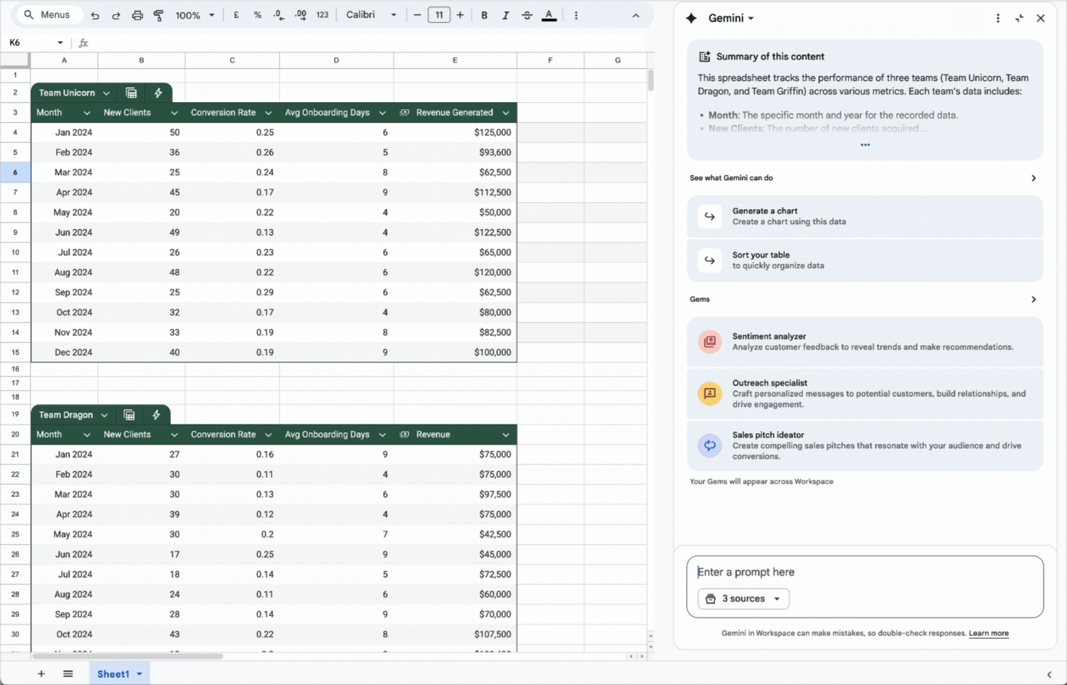
LAB 1 · SCREENSHOT
Gemini in Google Sheets: the Side Panel
Summary of the sheet, suggestions, Gems and the prompt box with its sources. Screenshot: Google Docs Editors Help - Collaborate with Gemini in Google Sheets
© Tertiary Infotech Academy Pte Ltd
Gemini for Google Sheet (C817) · C817
20

Slide 22
LAB 1 · COMPARE
Five Ways to Work with Gemini in Sheets
Side panel answer
Insert
Action
=AI function
Gem
What you do
Ask a question
Ask, then click Insert
Ask, then click Apply
Type =AI(...) in a cell
Pick your Gem in the panel
Changes the sheet?
No
Yes, when you insert
Yes - Undo available
Yes, when you generate
Only if you insert
Best for
Questions, insights
Tables, formulas, charts
Formatting, pivots, sort/filter
Row-by-row text
Repeatable expert tasks
Lab
1, 7
1, 5, 8
2, 3, 5
6
11
© Tertiary Infotech Academy Pte Ltd
Gemini for Google Sheet (C817) · C817
21

Slide 23
LAB 1 · CONCEPT
Prompting Gemini and the Side Panel
WHAT IT IS
WHY IT MATTERS
CHECK IT
• A prompt names the tab, columns, task and output. The panel adds sources, Insert, Retry, Undo and history.
• Precise prompts give precise answers; history is lost on reload, so insert what matters.
• Does your prompt say which tab, which columns and what the output should look like?
© Tertiary Infotech Academy Pte Ltd
Gemini for Google Sheet (C817) · C817
22

Slide 24
LAB 1 · HOW TO USE IT
Try It in Gemini — Prompting Gemini and the Side Panel
ASK GEMINI
THEN CHECK
• Using the Applications and Jobs tabs, make a table of applications and Openings per Position.
• Follow-up: add Applications_per_Opening and sort high to low.
• Then click Insert.
• The table has 8 positions.
• It survives a page reload.
© Tertiary Infotech Academy Pte Ltd
Gemini for Google Sheet (C817) · C817
23

Slide 25
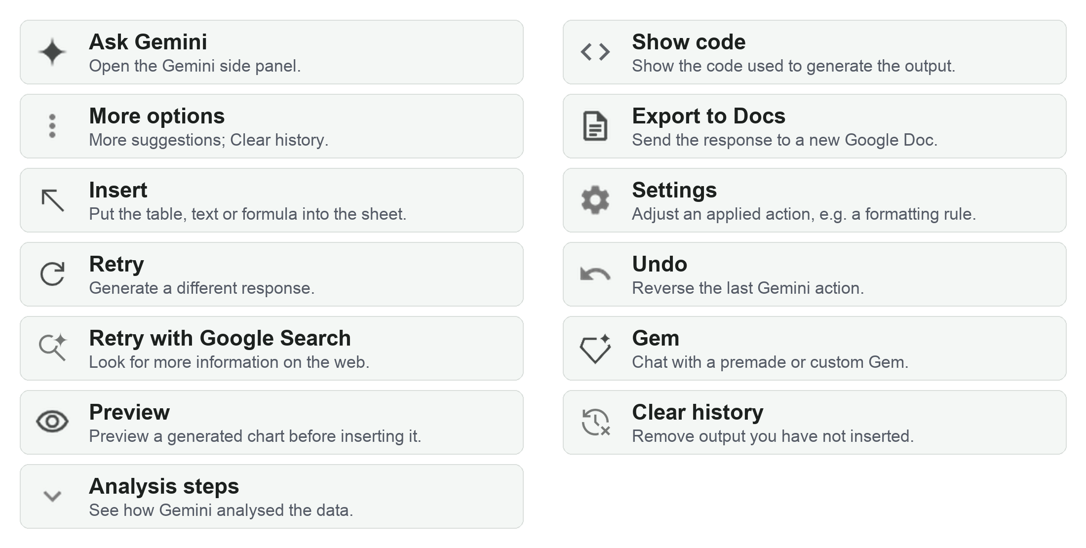
LAB 1 · SCREENSHOT
Gemini Panel Controls at a Glance
The controls from Google's Explore Gemini in Sheets table. Screenshot: Google Docs Editors Help - Collaborate with Gemini in Google Sheets
© Tertiary Infotech Academy Pte Ltd
Gemini for Google Sheet (C817) · C817
24

Slide 26
LAB 1 · INTERFACE
The Gemini Side Panel — What Each Part Does
Ask Gemini (spark)
Top right of Sheets. Opens the panel with a summary of the sheet.
1
Suggestions and Gems
Suggested prompts (More suggestions for others) and premade or custom Gems.
2
Prompt box and sources
Type a prompt; the sources dropdown picks which tabs Gemini uses.
3
Response controls
Insert, Copy, Retry, Preview, Analysis steps, Export to Docs, thumbs.
4
More options, Expand, Close
Clear history; make the panel larger; close it.
5
Screenshot: Google Docs Editors Help - Collaborate with Gemini in Google Sheets
© Tertiary Infotech Academy Pte Ltd
Gemini for Google Sheet (C817) · C817
25

Slide 27
LAB 1 · INTERFACE
Shortcuts and Key Controls
Insert / Copy
Keep a result: insert it into the sheet or copy it.
Retry
A different version; Retry with Google Search adds the web.
1
2
Analysis steps / Show code
See how Gemini calculated an answer.
Settings / Undo
Adjust or reverse the last action.
3
4
Shortcuts
Summarise: Cmd+Ctrl+N / Ctrl+Alt+N. Formula: = then Cmd+Ctrl+G / Ctrl+Alt+G.
5
© Tertiary Infotech Academy Pte Ltd
Gemini for Google Sheet (C817) · C817
26

Slide 28
LAB 1 THEME · GEMINI SIDE PANEL & SUMMARIES
Open Gemini and Explore the Q3 Candidate Export
LAB 1
You are a talent analyst at Orchid Bay Talent Partners, a fictional Singapore recruitment and HR firm. The Q3 2026 hiring drive has just closed its first round: 243 rows exported from the applicant tracking system for eight client roles. You will open the Gemini side panel, read its automatic summary, ask questions in plain English, focus Gemini on the tabs you choose, insert a table into the sheet, and try the panel's controls - Retry, Undo, feedback and Clear history.
You'll build
OrchidBay_Q3_Applications_Export as a Google Sheets file with an inserted Applications_by_Position table, a check formula that confirms Gemini's stage count, and a filled Prompt_Log
1 Open Gemini
2 Summarise
3 Ask across tabs
4 Insert
5 Spot issues
Tools: Google Sheets · Gemini side panel (summary, prompts, sources, Insert) · OrchidBay_Q3_Applications_Export.xlsx
© Tertiary Infotech Academy Pte Ltd
Gemini for Google Sheet (C817) · C817
27

Slide 29
LAB 1 · PROMPTS TO TRY
Sample Prompts — Lab 1
PROMPT
WHAT IT DOES
Summary: Give me a five-bullet summary of this candidate data for the Head of Talent.
Gemini condenses the export into five points for a manager - check each number against the sheet.
1
Question: Which Source brought in the most applications?
Counts applications per Source. Spelling variants such as 'Linked In' may split a source - you fix that in Lab 3.
2
Question: Which recruiter owns the most applications, and for which positions?
Counts applications per Recruiter and links each recruiter to their roles via Position.
3
Help: How do I freeze the header row in Google Sheets?
Gemini answers how-to questions about Google Sheets itself, step by step.
4
Insight: What's interesting about this data? Give three observations with the numbers behind them.
Gemini looks for patterns and backs each one with a number you can check with COUNTIF.
5
© Tertiary Infotech Academy Pte Ltd
Gemini for Google Sheet (C817) · C817
28

Slide 30
LAB 1 · VERIFY
Check Your Results — Lab 1
Rows and columns
243 rows of data, 16 columns; dates 2026-07-01 to 2026-09-26.
Applications_by_Position tab
8 positions; Data Analyst 41 applications for 2 openings; sorted by Applications_per_Opening.
1
2
Stage check
Rejected = 150 and Hired = 11, matching Gemini's answer.
Issues spotted
Gemini lists repeated IDs, Source spelling variants, blank or invalid emails, text salaries and a negative Years_Experience.
3
4
Prompt_Log
Every prompt you ran has What Gemini did, How I verified and a Decision.
5
© Tertiary Infotech Academy Pte Ltd
Gemini for Google Sheet (C817) · C817
29

Slide 31
LAB 2 · CONCEPT
Why Data Quality Matters
WHAT IT IS
WHY IT MATTERS
CHECK IT
• Complete, consistent, unique, valid data. Typical issues: duplicates, spelling variants, text numbers.
• Every count and chart inherits the errors - 'Linked In' and 'LinkedIn' become two sources.
• Profile before you analyse: rows vs unique IDs, distinct values, data types.
© Tertiary Infotech Academy Pte Ltd
Gemini for Google Sheet (C817) · C817
30

Slide 32
LAB 2 · HOW TO USE IT
Try It in Gemini — Why Data Quality Matters
ASK GEMINI
THEN CHECK
• Check the Applications tab for data-quality problems. Don't change anything.
• Highlight duplicate values in the Candidate_ID column in orange.
• List every distinct Source value exactly as spelt.
• 243 rows vs 240 unique IDs.
• =COUNTUNIQUE(...) confirms it.
© Tertiary Infotech Academy Pte Ltd
Gemini for Google Sheet (C817) · C817
31

Slide 33
LAB 2 THEME · DATA QUALITY CHECK
Check the Quality of the Candidate Data with Gemini
LAB 2
Before the recruitment manager sees any numbers, you check the raw Q3 export. You will ask Gemini to profile the data, find the repeated Candidate_IDs and the Source spelling variants, and apply conditional formatting actions that highlight duplicates, bad emails, text salaries and impossible values. A Checks tab of formulas confirms every count, and Gemini drafts a short data-quality report. You do not fix anything yet - that is Lab 3.
You'll build
OrchidBay_Q3_Applications_QualityCheck with duplicates and problem cells highlighted, a Checks tab of formulas confirming each issue count, an inserted data-quality report and a filled Prompt_Log
1 Profile
2 Find duplicates
3 Highlight issues
4 Count with formulas
5 Report
Tools: Google Sheets · Gemini side panel (questions, conditional-formatting actions, formulas) · OrchidBay_Q3_Applications_QualityCheck.xlsx
© Tertiary Infotech Academy Pte Ltd
Gemini for Google Sheet (C817) · C817
32

Slide 34
LAB 2 · PROMPTS TO TRY
Sample Prompts — Lab 2
PROMPT
WHAT IT DOES
Profile: Which columns have blank cells, and how many blanks does each have?
Gemini counts blanks per column - a fast completeness profile.
1
Validate: Are there any Applied_Date values outside July to September 2026?
A range check on dates: anything outside the hiring drive is suspicious.
2
Validate: Do any rows have a Position that doesn't match the Position for their Job_ID on the Jobs tab?
A cross-tab consistency check between Applications and the Jobs reference table.
3
Highlight: Highlight Full_Name cells that are all in capital letters in light purple.
Shows the 4 names typed in capitals, which Lab 3 tidies with PROPER.
4
Explain: Why is a salary stored as text a problem when I calculate an average?
Gemini explains the impact of a data-type problem in plain English.
5
© Tertiary Infotech Academy Pte Ltd
Gemini for Google Sheet (C817) · C817
33

Slide 35
LAB 2 · VERIFY
Check Your Results — Lab 2
Duplicates
243 rows, 240 unique IDs; CAN-26531, CAN-26601, CAN-26608 each appear twice; 6 orange cells.
Source variants
'Linked In' 3, 'linkedin' 2, 'JobStreet ' (trailing space) 3.
1
2
Emails
4 blank + 2 without @ (CAN-26697, CAN-26606) = 6 light-red cells.
Salaries and experience
5 text salaries in yellow; 1 negative Years_Experience (CAN-26607) in red.
3
4
Checks tab
Six formulas in column B match the expected values already in column C (243, 240, 4, 2, 5, 1).
5
© Tertiary Infotech Academy Pte Ltd
Gemini for Google Sheet (C817) · C817
34

Slide 36
LAB 3 · CONCEPT
Gemini Actions: Preview, Apply, Undo
WHAT IT IS
WHY IT MATTERS
CHECK IT
• A change Gemini makes from a prompt: shown on an Action preview card, applied when you click Apply.
• Menus become sentences - and the preview, Settings and Undo keep you in control.
• Did you check the result before your next change? Undo only lasts until then.
© Tertiary Infotech Academy Pte Ltd
Gemini for Google Sheet (C817) · C817
35

Slide 37
LAB 3 · HOW TO USE IT
Try It with Gemini Actions — Gemini Actions: Preview, Apply, Undo
ASK GEMINI, THEN APPLY
THEN CHECK
• In the Source column, replace 'Linked In' and 'linkedin' with 'LinkedIn'.
• Delete the Internal_Notes column.
• Freeze the top row and the first column.
• Sort the table by Applied_Date in descending order.
• Filter on Source shows 7 values.
• Still 240 rows after each change.
© Tertiary Infotech Academy Pte Ltd
Gemini for Google Sheet (C817) · C817
36

Slide 38
LAB 3 · CONCEPT
Data Prep: From Export to Clean Table
WHAT IT IS
WHY IT MATTERS
CHECK IT
• Turn an export into an analysis-ready table: no duplicates, one spelling per category, real numbers.
• Clean data is what makes every later formula, chart and AI answer trustworthy.
• Can you prove the row count before and after each change?
© Tertiary Infotech Academy Pte Ltd
Gemini for Google Sheet (C817) · C817
37

Slide 39
LAB 3 · HOW TO USE IT
Try It in Gemini — Data Prep: From Export to Clean Table
ASK GEMINI
THEN CHECK
• How can I remove duplicate rows on the Applications tab?
• Set Expected_Salary to currency S$ with no decimal places.
• Insert Name_Clean with =PROPER(TRIM(B2)) filled down.
• Apply a table style to the data.
• 240 rows, 7 sources.
• =COUNT on salaries = 240.
© Tertiary Infotech Academy Pte Ltd
Gemini for Google Sheet (C817) · C817
38

Slide 40
LAB 3 THEME · DATA PREP
Clean and Prepare the Candidate Data with Gemini Actions
LAB 3
You fix everything you found in Lab 2. Gemini explains how to remove duplicates, then performs actions for you: find and replace the Source variants, convert text salaries to numbers with a currency format, add a clean name column, delete the notes column, freeze the headers, apply a table style, and sort and filter the data. A multi-step prompt finishes the clean-up in one go. You check the row count after every change.
You'll build
OrchidBay_Q3_Applications_Prep as a clean table: 240 rows, seven Source values, numeric S$ salaries, a Name_Clean column, frozen headers, a Stage dropdown and Hired rows highlighted
1 Remove duplicates
2 Fix categories
3 Fix types
4 Restructure
5 Sort & filter
Tools: Google Sheets · Gemini actions (find and replace, number format, insert/delete column, freeze, sort, filter, table style) · Data cleanup
© Tertiary Infotech Academy Pte Ltd
Gemini for Google Sheet (C817) · C817
39

Slide 41
LAB 3 · PROMPTS TO TRY
Sample Prompts — Lab 3
PROMPT
WHAT IT DOES
Fill: Fill the empty Email cells with the text 'missing - ask candidate'.
Fill range: writes one value into every selected empty cell - flagging the gaps instead of hiding them.
1
Insert: Insert a new column called Source_Group after Source and leave it empty.
Insert dimension: adds an empty column exactly where you name it.
2
Number format: Format Screening_Score as a whole number and Interview_Score with one decimal place.
Set number format: controls how numbers display without changing their values.
3
Delete rows: Delete the rows where Stage is Withdrawn.
Delete dimension: removes rows that match a condition. Try it on a copy - then Undo.
4
Help: How do I split the Key_Skills column into separate columns?
Gemini explains Data > Split text to columns with ; as the separator.
5
© Tertiary Infotech Academy Pte Ltd
Gemini for Google Sheet (C817) · C817
40

Slide 42
LAB 3 · VERIFY
Check Your Results — Lab 3
Rows
240 rows after removing 3 duplicates.
Source
Exactly 7 values in the filter; LinkedIn 49, JobStreet 50.
1
2
Salaries
=COUNT over the Expected_Salary column returns 240; values show as S$ with no decimals.
Structure
Name_Clean filled to the last row; Internal_Notes gone; headers frozen; CAN-26607 shows 3 years.
3
4
Sort, filter, dropdown
Newest date (2026-09-26) at the top; the filter showed 2 rows; Stage dropdown added; 11 Hired rows light green.
5
© Tertiary Infotech Academy Pte Ltd
Gemini for Google Sheet (C817) · C817
41

Slide 43
LAB 4 · CONCEPT
Formulas: VLOOKUP, COUNTIF and Nested IF
WHAT IT IS
WHY IT MATTERS
CHECK IT
• VLOOKUP fetches from a table, IF decides, nested IF/AND handles several outcomes, COUNTIF(S) counts.
• Rules become repeatable and auditable - change a threshold once and everyone is re-screened.
• Can you work row 2 out by hand and get the same answer?
© Tertiary Infotech Academy Pte Ltd
Gemini for Google Sheet (C817) · C817
42

Slide 44
LAB 4 · HOW TO USE IT
Try It in Gemini — Formulas: VLOOKUP, COUNTIF and Nested IF
DESCRIBE THE RULE
THEN CHECK
• Look up the Job_ID in E2 on Jobs and return Min_Years.
• Return Within budget if K2 <= Q2, otherwise Above budget.
• Strong if M2 >= pass mark AND H2 >= R2; Possible if M2 >= 60; else Not suitable.
• Row 2 checked by hand.
• Totals add up to 240.
© Tertiary Infotech Academy Pte Ltd
Gemini for Google Sheet (C817) · C817
43

Slide 45
LAB 4 · CONCEPT
Generate, Explain and Fix Formulas with Gemini
WHAT IT IS
WHY IT MATTERS
CHECK IT
• Describe it and Gemini writes it; ask and Gemini explains it; hover an error and Fix repairs it.
• No syntax to memorise - but you still read, explain and check every formula.
• Could you explain this formula to a colleague in one sentence?
© Tertiary Infotech Academy Pte Ltd
Gemini for Google Sheet (C817) · C817
44

Slide 46
LAB 4 · HOW TO USE IT
Try It in Gemini — Generate, Explain and Fix Formulas with Gemini
ASK GEMINI FOR THE FORMULA
THEN CHECK
• Type = in a cell, then Cmd + Ctrl + G (Mac) / Ctrl + Alt + G.
• Explain the formula in T2 step by step.
• Hover over #REF! > Fix.
• Q2 shows S$6,500 after Fix.
• Explanation matches row 2.
© Tertiary Infotech Academy Pte Ltd
Gemini for Google Sheet (C817) · C817
45

Slide 47
LAB 4 THEME · FORMULAS: VLOOKUP, COUNTIF & NESTED IF
Generate, Explain and Fix Screening Formulas
LAB 4
The hiring managers want a first screen of all 240 applications. You will fix a broken lookup with Gemini's Fix button, then describe each rule in plain English and let Gemini write the formula: a VLOOKUP for the role's minimum experience, an IF for salary fit, and a nested IF with AND that labels each candidate Strong, Possible or Not suitable. Gemini explains the formula, COUNTIF and COUNTIFS summarise the results, and independent check formulas prove them.
You'll build
OrchidBay_Screening_Formulas with working Budget_Max, Min_Years, Salary_Fit and Screen_Result columns, a Checks tab of COUNTIF/COUNTIFS results that reconcile to 240, and a filled Prompt_Log
1 Fix an error
2 VLOOKUP
3 IF
4 Nested IF
5 COUNTIF & check
Tools: Google Sheets · Gemini formula help (side panel, = then Cmd/Ctrl + Ctrl/Alt + G, Fix) · OrchidBay_Screening_Formulas.xlsx
© Tertiary Infotech Academy Pte Ltd
Gemini for Google Sheet (C817) · C817
46

Slide 48
LAB 4 · PROMPTS TO TRY
Sample Prompts — Lab 4
PROMPT
WHAT IT DOES
Lookup: Create a formula that returns the Hiring_Manager for the Job_ID in E2 from the Jobs tab (A2:J9).
VLOOKUP again, returning a different column (10, Hiring_Manager).
1
Date: Create a formula for the number of days between Applied_Date in D2 and the report date in Settings!B1.
Writes =Settings!$B$1-D2: subtracting dates gives the number of days.
2
Text: Create a formula that returns TRUE if Key_Skills in J2 contains "SQL".
Writes =REGEXMATCH(J2,"SQL") or =ISNUMBER(SEARCH("SQL",J2)) - a keyword screen.
3
Count: Create a formula that counts Above budget candidates for each Position.
Gemini may build a small table of COUNTIFS - check one row by hand.
4
Explain: Explain the difference between VLOOKUP and XLOOKUP, and when to use each.
Gemini explains both lookups; XLOOKUP needs no column number and can look left.
5
© Tertiary Infotech Academy Pte Ltd
Gemini for Google Sheet (C817) · C817
47

Slide 49
LAB 4 · VERIFY
Check Your Results — Lab 4
Fix
Q2 = S$6,500; no #REF! left in column Q.
Row 2
CAN-26481: Min_Years 2, Salary_Fit Within budget, Screen_Result Possible.
1
2
Screen_Result totals
Strong 88 + Possible 73 + Not suitable 79 = 240.
COUNTIFS
Strong Data Analysts = 14; Above budget = 62 (Within budget 178).
3
4
What-if
Pass mark 75 gives 60 Strong; set back to 70 gives 88.
5
© Tertiary Infotech Academy Pte Ltd
Gemini for Google Sheet (C817) · C817
48

Slide 50
TOPIC RECAP
Recap - Fundamentals of Google Sheet
LO1 · Side panel: Summaries, questions across chosen tabs, Insert, Retry, Undo and Clear history.
LO1 · Data quality: Duplicates, spelling variants, bad emails, text numbers and impossible values found and counted.
1
2
LO1 · Data prep: Gemini actions - find and replace, number format, insert/delete, freeze, sort, filter - with counts before and after.
LO1 · Formulas: VLOOKUP, IF, nested IF and COUNTIFS from plain English; explained, fixed and reconciled.
3
4
© Tertiary Infotech Academy Pte Ltd
Gemini for Google Sheet (C817) · C817
49

Slide 51
TOPIC 02
Data Analytics and Visualization
tables, trackers and dropdowns · conditional formatting · the AI function and Fill with Gemini · data analysis, insights and pivot tables · charts and graphs
© Tertiary Infotech Academy Pte Ltd
Gemini for Google Sheet (C817) · C817
50

Slide 52
KEY CONCEPTS · LABS 5-8
Key Concepts — Data Analytics and Visualization
Structure from text
Gemini turns notes into a table you refine before you insert it.
Rules that colour
Conditional formatting flags what matters; Settings lets you edit the rule.
1
2
AI in a cell
=AI(prompt, range) extracts, categorises and summarises text row by row.
Insights with evidence
Analysis steps show how Gemini calculated; you confirm with a formula.
3
4
Pivot tables on request
Gemini builds a pivot table; you adjust it and check its totals.
Inserted charts are copies
A chart Gemini inserts doesn't follow later changes - build linked ones too.
5
6
© Tertiary Infotech Academy Pte Ltd
Gemini for Google Sheet (C817) · C817
51

Slide 53
WHAT YOU'LL DO
Hands-On Labs — Data Analytics and Visualization
Labs 5–6
Labs 7–8
• Tables, Trackers & Conditional Formatting
– Build a Colour-Coded Interview Tracker from Unstructured Notes
• AI Function & Fill with Gemini
– Extract and Categorise Candidate Text with the AI Function
• Data Analysis & Insights
– Generate Hiring Insights and Pivot Tables with Gemini
• Charts & Visualisation
– Build Charts That Tell the Hiring Story
© Tertiary Infotech Academy Pte Ltd
Gemini for Google Sheet (C817) · C817
52

Slide 54
LAB 5 · CONCEPT
Tables, Trackers and Dropdowns
WHAT IT IS
WHY IT MATTERS
CHECK IT
• Gemini builds tables from scratch or from notes; dropdowns and checkboxes keep trackers consistent.
• Consistent input today means reliable analysis tomorrow.
• Does every note appear once, with a valid Status?
© Tertiary Infotech Academy Pte Ltd
Gemini for Google Sheet (C817) · C817
53

Slide 55
LAB 5 · HOW TO USE IT
Try It in Gemini — Tables, Trackers and Dropdowns
ASK GEMINI, THEN INSERT
THEN CHECK
• Using the notes on Interview_Notes, create a table with Date, Time, Candidate ... and Status.
• Follow-up: add Outcome and Reference_Checked columns.
• Make Status a dropdown with Scheduled, Completed, No-show and Rescheduled.
• 12 rows; statuses 5/3/2/2.
• Dropdowns and checkboxes work.
© Tertiary Infotech Academy Pte Ltd
Gemini for Google Sheet (C817) · C817
54

Slide 56
LAB 5 · CONCEPT
Conditional Formatting with Gemini
WHAT IT IS
WHY IT MATTERS
CHECK IT
• Formatting that follows a rule: highlight rows, compare columns, colour scales, duplicates.
• Exceptions jump out without changing the data - and update as the data changes.
• Does a COUNTIF give the same number as the coloured rows?
© Tertiary Infotech Academy Pte Ltd
Gemini for Google Sheet (C817) · C817
55

Slide 57
LAB 5 · HOW TO USE IT
Try It in Gemini — Conditional Formatting with Gemini
ASK GEMINI, THEN APPLY
THEN CHECK
• Highlight rows where Screening_Score is 85 or more in light green.
• Make Expected_Salary bold red when it is greater than Budget_Max.
• Add a colour scale to Interview_Score from red to green.
• 11 green rows (21 at 80).
• 12 red salaries.
© Tertiary Infotech Academy Pte Ltd
Gemini for Google Sheet (C817) · C817
56

Slide 58
LAB 5 THEME · TABLES, TRACKERS & CONDITIONAL FORMATTING
Build a Colour-Coded Interview Tracker from Unstructured Notes
LAB 5
The recruiters typed this week's interview notes as free text. You will ask Gemini to turn them into a structured table, refine it before inserting, and make it a working tracker with Status and Outcome dropdowns and a Reference_Checked checkbox. Conditional-formatting actions colour-code the tracker and flag the shortlist: top screening scores, salaries above budget and long notice periods. You will edit a rule with Settings, run a multi-step clean-up prompt, and create an onboarding checklist from scratch.
You'll build
OrchidBay_Interview_Tracker with an Interview_Tracker tab (12 interviews, dropdowns, checkboxes, colour-coded Status), a flagged Shortlist tab and a new Onboarding_Checklist tab
1 Notes to table
2 Dropdowns & checkboxes
3 Colour-code
4 Flag the shortlist
5 Multi-step clean-up
Tools: Google Sheets · Gemini (create tables, Insert, dropdown, checkbox and conditional-formatting actions, Settings) · OrchidBay_Interview_Tracker.xlsx
© Tertiary Infotech Academy Pte Ltd
Gemini for Google Sheet (C817) · C817
57

Slide 59
LAB 5 · PROMPTS TO TRY
Sample Prompts — Lab 5
PROMPT
WHAT IT DOES
Table: Create a table of interview questions for a Data Analyst, with columns Question, Skill tested and What a good answer includes.
Gemini drafts a structured interview guide you can insert and reuse.
1
Dropdown: Convert the Recruiter column on the Shortlist tab to a dropdown with values from the same column.
Turns an existing column into a dropdown of its own values.
2
Highlight: Highlight the Shortlist rows where Stage is Offered in light purple.
Another row-highlight rule - check the count with COUNTIF.
3
Freeze: Freeze the top row and the first two columns of the Shortlist tab.
A freeze action keeps IDs and names visible as you scroll right.
4
Help: Teach me how to use conditional formatting with a custom formula.
Gemini explains custom-formula rules in Format > Conditional formatting, step by step.
5
© Tertiary Infotech Academy Pte Ltd
Gemini for Google Sheet (C817) · C817
58

Slide 60
LAB 5 · VERIFY
Check Your Results — Lab 5
Interview_Tracker
12 rows; Completed 5, Scheduled 3, Rescheduled 2, No-show 2.
Tracker controls
Status and Outcome dropdowns work; Reference_Checked has checkboxes; Status is colour-coded.
1
2
Shortlist flags
11 green rows at 85, then 21 after editing the rule to 80; 12 salaries in bold red; Interview_Score has a colour scale.
Multi-step
Stage dropdown, Notice_End dates, Contacted checkboxes; 5 light-orange rows.
3
4
Onboarding_Checklist
13 tasks (10 + 3 IT tasks) with a Done checkbox column.
5
© Tertiary Infotech Academy Pte Ltd
Gemini for Google Sheet (C817) · C817
59

Slide 61
LAB 6 · CONCEPT
The AI Function (=AI)
WHAT IT IS
WHY IT MATTERS
CHECK IT
• =AI("prompt", range) in a cell: generate, summarise, categorise, or search - row by row.
• Free text becomes columns you can filter and count - once you have measured the accuracy.
• How many AI answers match the recorded values?
© Tertiary Infotech Academy Pte Ltd
Gemini for Google Sheet (C817) · C817
60

Slide 62
LAB 6 · HOW TO USE IT
Try It in Gemini — The AI Function (=AI)
TYPE IN A CELL
THEN CHECK
• =AI("Extract the notice period in weeks. Output only the number.", D2)
• =AI("Classify this feedback as Positive, Mixed or Negative.", E2)
• Select the cells > Generate and insert.
• Notice matches near 30/30.
• Sentiment split vs Answer_Key.
© Tertiary Infotech Academy Pte Ltd
Gemini for Google Sheet (C817) · C817
61

Slide 63
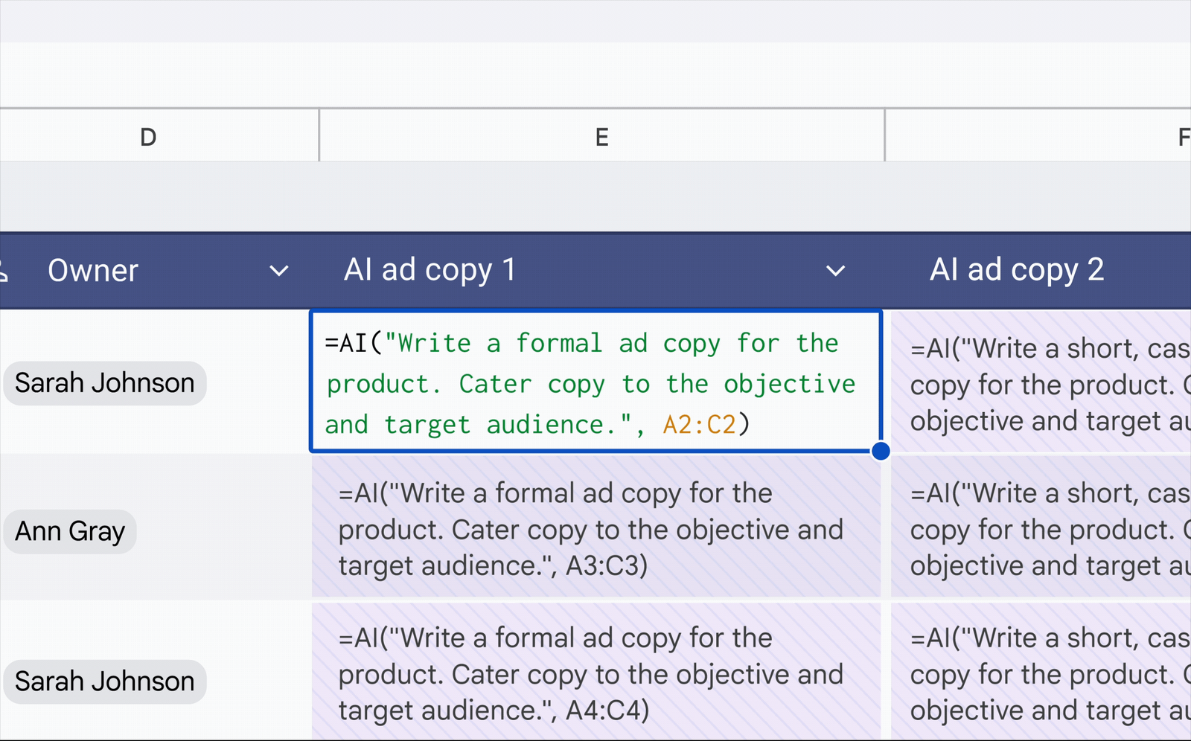
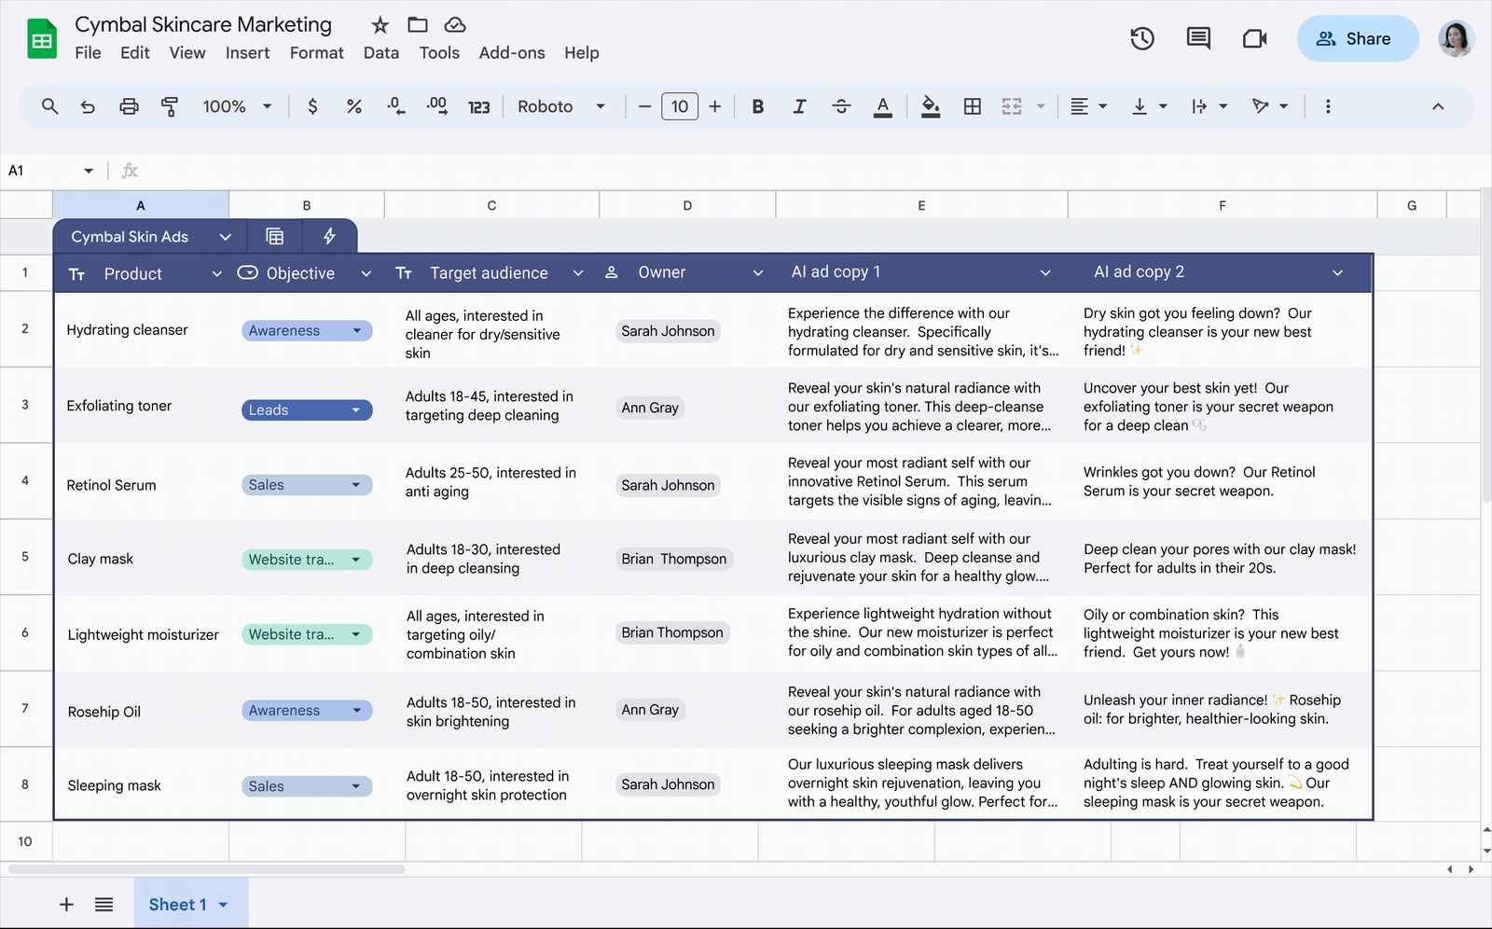
LAB 6 · SCREENSHOT
The AI Function in Google Sheets
Type the =AI formula
A prompt plus the cells it should use.
Generate and insert
Gemini fills every selected AI cell.
Screenshot: Google Docs Editors Help - Collaborate with Gemini in Google Sheets
© Tertiary Infotech Academy Pte Ltd
Gemini for Google Sheet (C817) · C817
62

Slide 64
LAB 6 · HOW TO USE IT
Fill with Gemini and AI Columns
ASK GEMINI
THEN CHECK
• Type an example in I2, select I2:I31 > Fill.
• Group the Interview_Feedback into themes and count each.
• Do any summaries mention personal characteristics?
• I2:I31 filled.
• Theme counts add up to 30.
© Tertiary Infotech Academy Pte Ltd
Gemini for Google Sheet (C817) · C817
63

Slide 65
LAB 6 THEME · AI FUNCTION & FILL WITH GEMINI
Extract and Categorise Candidate Text with the AI Function
LAB 6
Hiring managers want a quick read of 30 shortlisted candidates, but the details are buried in free text. You will type =AI formulas that extract the notice period in weeks, classify each interview feedback as Positive, Mixed or Negative, and write a one-line summary that leaves out personal characteristics. You will generate the outputs, compare them with an answer key using formulas, use Fill with Gemini for a skills column, and ask the side panel to group the feedback into themes.
You'll build
OrchidBay_Candidate_Profiles with AI-filled Notice_Weeks_AI, Feedback_Sentiment_AI, Manager_Summary_AI and Top_Skills columns, a Checks tab measuring accuracy, and an inserted feedback-themes table
1 Extract
2 Categorise
3 Summarise
4 Measure accuracy
5 Fill & group
Tools: Google Sheets · AI function (=AI, Generate and insert) · Fill with Gemini · Gemini side panel · OrchidBay_Candidate_Profiles.xlsx
© Tertiary Infotech Academy Pte Ltd
Gemini for Google Sheet (C817) · C817
64

Slide 66
LAB 6 · PROMPTS TO TRY
Sample Prompts — Lab 6
PROMPT
WHAT IT DOES
AI function: =AI("Does this candidate mention SQL? Answer Yes or No.", D2)
A yes/no extraction - easy to check with SEARCH or REGEXMATCH.
1
AI function: =AI("Write a polite two-sentence email inviting this candidate to a second interview.", B2:C2)
Generates text from two cells - always read it before sending anything.
2
Categorise: =AI("Classify the seniority of this candidate as Junior, Mid or Senior based on years of experience.", D2)
Categorises into your own definitions; give the definitions in the prompt for consistent results.
3
Side panel: Which five candidates have the most positive feedback? Show their names and positions.
The side panel answers across all 30 rows at once.
4
Side panel: Summarise the main concerns interviewers raised, with the number of candidates for each.
Turns free text into counted themes you can act on.
5
© Tertiary Infotech Academy Pte Ltd
Gemini for Google Sheet (C817) · C817
65

Slide 67
LAB 6 · VERIFY
Check Your Results — Lab 6
Notice_Weeks_AI
30 numbers; row 2 = 0; Notice matches close to 30 (recorded: 8 candidates with 8+ weeks).
Feedback_Sentiment_AI
Recorded split Positive 9, Mixed 16, Negative 5; your Sentiment matches count shows how many agree.
1
2
Manager_Summary_AI
H2:H6 filled with one sentence each and no personal characteristics.
Top_Skills
I2:I31 filled by Fill with Gemini (or =AI), following your example in I2.
3
4
Feedback_Themes
An inserted themes table whose counts add up to 30.
5
© Tertiary Infotech Academy Pte Ltd
Gemini for Google Sheet (C817) · C817
66

Slide 68
LAB 7 · CONCEPT
Data Analysis and Insights with Gemini
WHAT IT IS
WHY IT MATTERS
CHECK IT
• Ask questions of the data: trends, comparisons, rates. Analysis steps shows the working.
• A first answer in seconds - made defensible with a formula check.
• Which number in Gemini's insight did you confirm with COUNTIFS?
© Tertiary Infotech Academy Pte Ltd
Gemini for Google Sheet (C817) · C817
67

Slide 69
LAB 7 · HOW TO USE IT
Try It in Gemini — Data Analysis and Insights with Gemini
ASK GEMINI
THEN CHECK
• What analysis can you help me perform with this sheet?
• Identify trends in applications by Month.
• Which Source has the best hire rate?
• Export to Docs.
• Peak June 98.
• Referral 12.8%.
© Tertiary Infotech Academy Pte Ltd
Gemini for Google Sheet (C817) · C817
68

Slide 70
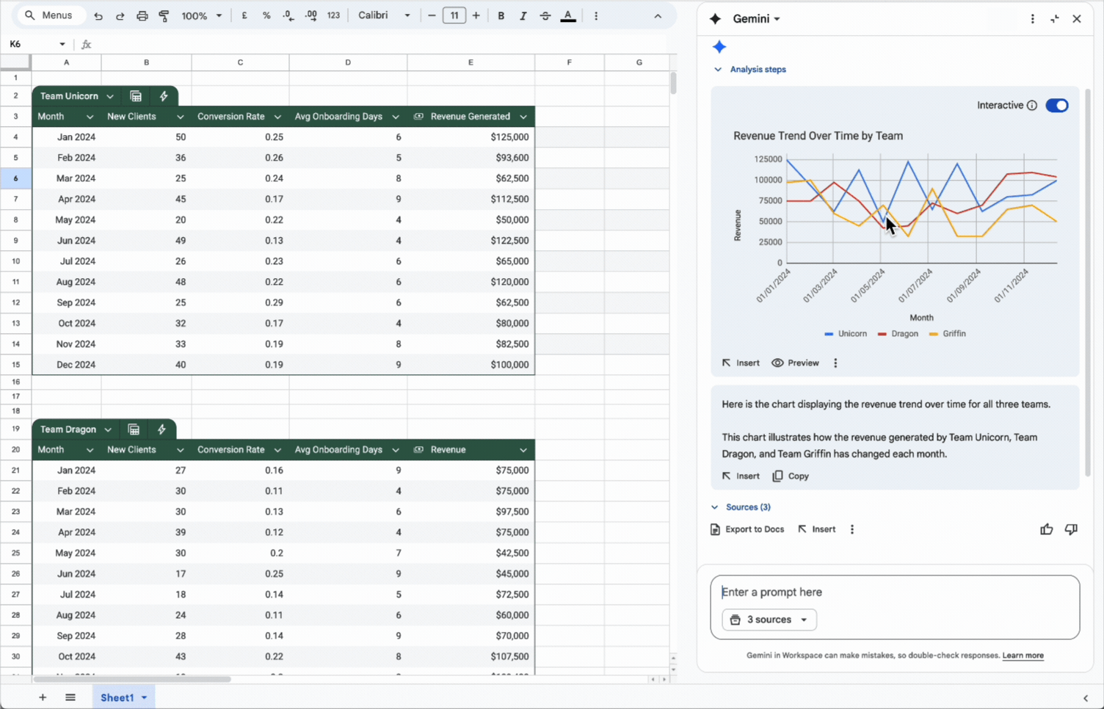
LAB 7 · SCREENSHOT
A Gemini Analysis Response
Analysis steps, Insert, Preview, Copy, Sources, Export to Docs and feedback. Screenshot: Google Docs Editors Help - Collaborate with Gemini in Google Sheets
© Tertiary Infotech Academy Pte Ltd
Gemini for Google Sheet (C817) · C817
69

Slide 71
LAB 7 · HOW TO USE IT
Pivot Tables with Gemini
ASK GEMINI, THEN APPLY
THEN CHECK
• Create a pivot table: count of Candidate_ID, Source in rows, Stage in columns.
• Click Settings to add a filter.
• =COUNTIFS(... "LinkedIn" ... "Hired")
• Grand total 720.
• LinkedIn Hired 11.
© Tertiary Infotech Academy Pte Ltd
Gemini for Google Sheet (C817) · C817
70

Slide 72
LAB 7 THEME · DATA ANALYSIS & INSIGHTS
Generate Hiring Insights and Pivot Tables with Gemini
LAB 7
Orchid Bay's Head of Talent wants to know how 2026 hiring is going. Using all 720 applications from January to September, you will ask Gemini what analysis is possible, find the monthly trend, compare sources by hire rate and cost per hire, and find which role takes longest to fill. You will open Analysis steps to see how Gemini calculated, create pivot tables with Gemini actions and adjust them with Settings, check every figure with COUNTIFS or AVERAGEIFS, and export five insights to a Google Doc.
You'll build
OrchidBay_Hiring_2026_YTD with two pivot tables (source by stage, days to hire by position), a Checks area of formulas, and a Google Doc of insights exported from Gemini
1 Explore
2 Trends
3 Compare sources
4 Pivot tables
5 Export insights
Tools: Google Sheets · Gemini data analysis (Analysis steps, Export to Docs) · pivot-table actions · OrchidBay_Hiring_2026_YTD.xlsx
© Tertiary Infotech Academy Pte Ltd
Gemini for Google Sheet (C817) · C817
71

Slide 73
LAB 7 · PROMPTS TO TRY
Sample Prompts — Lab 7
PROMPT
WHAT IT DOES
Trend: How did the number of hires change from Q1 to Q2 to Q3 2026?
Groups months into quarters - check it with COUNTIFS on Month.
1
Compare: Compare the average Screening_Score of hired and rejected candidates.
Compares two groups on one measure - is screening predicting who gets hired?
2
Pivot: Create a pivot table that shows the number of hires by Recruiter and Month.
A two-dimensional pivot table, created and adjustable with Settings.
3
Regression: How can I show regression and prediction of monthly applications?
Gemini explains trend lines and forecasting - treat any prediction as an estimate.
4
Explain: Explain this analysis like I'm a hiring manager with no data background.
Asks Gemini to rewrite the same findings for a different audience.
5
© Tertiary Infotech Academy Pte Ltd
Gemini for Google Sheet (C817) · C817
72

Slide 74
LAB 7 · VERIFY
Check Your Results — Lab 7
Trend
Peak June 2026 (98 applications); lowest February (62).
Sources
Best hire rate Referral 12.8%; most hires LinkedIn (11); 41 hires in total.
1
2
Pivot 1
Source x Stage; LinkedIn Hired 11, Rejected 147; grand total 720.
Pivot 2
HR Executive slowest at 39.3 days; AVERAGEIFS matches.
3
4
Cost per hire
Cheapest Company Website S$125; dearest Career Fair S$1,540; insights exported to a Google Doc.
5
© Tertiary Infotech Academy Pte Ltd
Gemini for Google Sheet (C817) · C817
73

Slide 75
LAB 8 · CONCEPT
Charts and Graphs with Gemini
WHAT IT IS
WHY IT MATTERS
CHECK IT
• Describe the chart; Preview, then Insert. Gemini adds a new tab with the chart and its data.
• A good chart makes the finding obvious - and its title should say it.
• Does the title state the finding, not just the measure?
© Tertiary Infotech Academy Pte Ltd
Gemini for Google Sheet (C817) · C817
74

Slide 76
LAB 8 · HOW TO USE IT
Try It in Gemini — Charts and Graphs with Gemini
ASK GEMINI, THEN INSERT
THEN CHECK
• Create a line chart with Month on the x-axis and applications on the y-axis.
• Make a bar chart of hires by Source, sorted from most to fewest.
• Suggest a title for each chart that states the main finding.
• Peak June 98.
• Funnel 720/61/47/41.
© Tertiary Infotech Academy Pte Ltd
Gemini for Google Sheet (C817) · C817
75

Slide 77
LAB 8 · HOW TO USE IT
Inserted vs Linked Charts
ASK GEMINI
THEN CHECK
• Will the chart you inserted update if I change the Applications tab?
• Create a pivot table that counts Candidate_ID by Month.
• Then Insert > Chart on the pivot table.
• Inserted chart unchanged.
• Pivot chart updated.
© Tertiary Infotech Academy Pte Ltd
Gemini for Google Sheet (C817) · C817
76

Slide 78
LAB 8 THEME · CHARTS & VISUALISATION
Build Charts That Tell the Hiring Story
LAB 8
Now you show the findings from Lab 7. You will ask Gemini to create charts - a monthly trend line, hires by source and the hiring funnel - preview them and insert them. Each inserted chart lands on a new tab with its own copy of the data, so it does not update when Applications changes. You will prove that, then build a linked chart from a pivot table that does update. A cost-per-hire chart combines two tabs, and you will rewrite every title to state its finding and add alt text.
You'll build
OrchidBay_Hiring_Charts with four inserted Gemini charts, one linked chart built from a pivot table, finding-based titles and alt text
1 Trend chart
2 Source & funnel
3 Static vs linked
4 Cost chart
5 Titles & alt text
Tools: Google Sheets · Gemini charts (Preview, Insert, Copy chart) · pivot table · Chart editor · OrchidBay_Hiring_Charts.xlsx
© Tertiary Infotech Academy Pte Ltd
Gemini for Google Sheet (C817) · C817
77

Slide 79
LAB 8 · PROMPTS TO TRY
Sample Prompts — Lab 8
PROMPT
WHAT IT DOES
Pie: Create a pie chart of applications by Source.
Shows each source's share - LinkedIn is 25.6% of applications. Pies suit a few categories only.
1
Stacked: Create a stacked column chart of applications by Month, split by Stage.
Shows totals and the stage mix together.
2
Combo: Create a chart with applications as columns and hires as a line, by Month.
Two measures on one chart - check that the two axes are labelled.
3
Help: What chart type is best to show the share of each source over time?
Gemini as a chart adviser - it explains the trade-offs.
4
Graph: Create a graph that shows the percentage of applications that came from each Position.
A percentage chart - check the slices add up to 100%.
5
© Tertiary Infotech Academy Pte Ltd
Gemini for Google Sheet (C817) · C817
78

Slide 80
LAB 8 · VERIFY
Check Your Results — Lab 8
Trend chart
Line chart on its own tab; peak June 98.
Source and funnel
Bars sorted; LinkedIn 11 first. Funnel 720 / 61 / 47 / 41.
1
2
Static vs linked
Inserted chart did not change after the Stage edit; the Month x Stage pivot chart did.
Cost per hire
Company Website S$125 lowest; Career Fair S$1,540 highest.
3
4
Titles and alt text
Every chart title states a finding; every chart has alt text.
5
© Tertiary Infotech Academy Pte Ltd
Gemini for Google Sheet (C817) · C817
79

Slide 81
TOPIC RECAP
Recap - Data Analytics and Visualization
LO2 · Tables and trackers: Notes turned into a colour-coded tracker with dropdowns, checkboxes and editable rules.
LO2 · AI function: =AI extracts, categorises and summarises text; accuracy measured against an answer key.
1
2
LO2 · Analysis: Trends, rates and cost per hire with Analysis steps; pivot tables checked with COUNTIFS.
LO2 · Charts: Inserted (static) and linked charts; titles that state the finding; alt text.
3
4
© Tertiary Infotech Academy Pte Ltd
Gemini for Google Sheet (C817) · C817
80

Slide 82
TOPIC 03
Interactive Dashboard
dropdown selectors and KPI formulas · linked charts, alerts and protection · Gems for repeatable screening · optimisation, reporting and responsible sharing
© Tertiary Infotech Academy Pte Ltd
Gemini for Google Sheet (C817) · C817
81

Slide 83
KEY CONCEPTS · LABS 9-12
Key Concepts — Interactive Dashboard
Selectors drive everything
Dropdowns feed COUNTIFS; 'All' becomes the wildcard *.
KPIs are formulas
Never type a number Gemini told you - the dashboard must recalculate.
1
2
Charts on live ranges
Insert > Chart on the dashboard tables, so charts follow the dropdowns.
Gems for repeat work
Saved instructions + knowledge files = the same screening every time.
3
4
Optimise, then decide
Gemini's solver finds the best combination; a person makes the call.
Share the minimum
Only the fields a viewer needs, view-only, after the external-sharing warning.
5
6
© Tertiary Infotech Academy Pte Ltd
Gemini for Google Sheet (C817) · C817
82

Slide 84
WHAT YOU'LL DO
Hands-On Labs — Interactive Dashboard
Labs 9–10
Labs 11–12
• Dashboard KPIs & Selectors
– Build the Dashboard's Selectors and KPI Formulas
• Interactive Dashboard
– Make the Hiring Dashboard Interactive and Visual
• Gems
– Create a Candidate Screener Gem and Use It in Sheets
• Optimisation, Reporting & Safe Sharing
– Optimise the Hiring Decision and Share Results Safely
© Tertiary Infotech Academy Pte Ltd
Gemini for Google Sheet (C817) · C817
83

Slide 85
LAB 9 · HOW TO USE IT
What Makes a Dashboard Interactive
ASK GEMINI, THEN APPLY
THEN CHECK
• Create a dropdown in C3 with the values from Lists!A2:A10.
• Create a dropdown in C4 with the values from Lists!B2:B9.
• Set both to All.
• C3 lists All + 8 positions.
• C4 lists All + 7 sources.
© Tertiary Infotech Academy Pte Ltd
Gemini for Google Sheet (C817) · C817
84

Slide 86
LAB 9 · CONCEPT
KPI Formulas Driven by Dropdowns
WHAT IT IS
WHY IT MATTERS
CHECK IT
• COUNTIFS/AVERAGEIFS with IF($C$3="All","*",$C$3): every KPI follows the dropdowns.
• Formula KPIs recalculate instantly - test 'All', one group and an empty mix.
• What does your formula return when a combination has no rows?
© Tertiary Infotech Academy Pte Ltd
Gemini for Google Sheet (C817) · C817
85

Slide 87
LAB 9 · HOW TO USE IT
Try It in Gemini — KPI Formulas Driven by Dropdowns
DESCRIBE THE KPI
THEN CHECK
• Count rows where Position = C3 and Source = C4; All means any value.
• Hires: the same count where Stage is Hired.
• Hire rate: E7/B7, 0 if B7 is 0.
• All/All: 720 and 41.
• No #DIV/0! anywhere.
© Tertiary Infotech Academy Pte Ltd
Gemini for Google Sheet (C817) · C817
86

Slide 88
LAB 9 THEME · DASHBOARD KPIS & SELECTORS
Build the Dashboard's Selectors and KPI Formulas
LAB 9
The Head of Talent wants one page that answers 'how is hiring going?' for any role and any source. You will turn two cells into dropdown selectors, then ask Gemini for the formulas: COUNTIFS that treat 'All' as 'every value', a hire rate, AVERAGEIFS for screening score and days to hire, and the funnel, monthly and source tables that the charts in Lab 10 will use. Every KPI is a formula, never a typed number, so it changes when the selectors change - and you test that it does.
You'll build
OrchidBay_Dashboard_Build with Position and Source dropdowns in C3:C4, a KPI row (B7:H7) and funnel, monthly and source tables that all respond to the dropdowns
1 Selectors
2 Count KPIs
3 Rate & average KPIs
4 Summary tables
5 Test the filters
Tools: Google Sheets · Gemini dropdown actions and formula generation (COUNTIFS, AVERAGEIFS, IFERROR) · OrchidBay_Dashboard_Build.xlsx
© Tertiary Infotech Academy Pte Ltd
Gemini for Google Sheet (C817) · C817
87

Slide 89
LAB 9 · PROMPTS TO TRY
Sample Prompts — Lab 9
PROMPT
WHAT IT DOES
KPI: Create a formula for the offer acceptance rate: Hired divided by Offered plus Hired, for the selected Position and Source.
A ratio KPI built from two COUNTIFS - check it on one position by hand.
1
KPI: Create a formula that returns the most common Source for the selected Position.
Gemini may use INDEX/MATCH or QUERY; verify with the Lab 7 source table.
2
Selector: Create a dropdown in C5 with the values 2026-01 to 2026-09.
A third selector you could add to the COUNTIFS criteria.
3
Explain: Explain the formula in B7 to someone who has never used COUNTIFS.
A plain-language explanation for a colleague who will maintain the dashboard.
4
Check: Which formulas on the Dashboard tab would break if a new Position were added?
Gemini reviews the dashboard's robustness - the Lists ranges are fixed-size.
5
© Tertiary Infotech Academy Pte Ltd
Gemini for Google Sheet (C817) · C817
88

Slide 90
LAB 9 · VERIFY
Check Your Results — Lab 9
Selectors
C3 lists All + 8 positions; C4 lists All + 7 sources.
All / All
B7:H7 = 720, 61, 47, 41, 5.7%, 65.5, 31.1.
1
2
Tables
Funnel 720/61/47/41; June applications 98; LinkedIn hires 11.
Software Engineer
104 applications, 6 hires, 5.8%; the COUNTIFS check shows 6.
3
4
Data Analyst + LinkedIn
30 applications, 0 hires; H7 shows '-' (no error).
5
© Tertiary Infotech Academy Pte Ltd
Gemini for Google Sheet (C817) · C817
89

Slide 91
LAB 10 · CONCEPT
Dashboard Design: Charts, Alerts and Protection
WHAT IT IS
WHY IT MATTERS
CHECK IT
• Selectors on top, KPIs in a row, linked charts below, alerts on the KPIs, everything else protected.
• Other people will use it - clarity, alerts and protection make it trustworthy.
• Change a dropdown: does every chart redraw?
© Tertiary Infotech Academy Pte Ltd
Gemini for Google Sheet (C817) · C817
90

Slide 92
LAB 10 · HOW IT WORKS
From KPI Formulas to Dashboard
1
2
3
4
5
▶
▶
▶
▶
Selectors and KPI formulas (Lab 9)
Linked charts on dashboard tables
Metric switch
KPI alerts
Protect, summarise, share
© Tertiary Infotech Academy Pte Ltd
Gemini for Google Sheet (C817) · C817
91

Slide 93
LAB 10 · HOW TO USE IT
Build It with Gemini — Dashboard Design: Charts, Alerts and Protection
ASK GEMINI
THEN CHECK
• How do I insert a chart from a range so that it updates?
• Create a dropdown in C5 with Applications and Hires.
• Highlight F7 in light red when it is below 5%.
• Charts redraw for each Position.
• Alerts fire for HR Executive.
© Tertiary Infotech Academy Pte Ltd
Gemini for Google Sheet (C817) · C817
92

Slide 94
LAB 10 THEME · INTERACTIVE DASHBOARD
Make the Hiring Dashboard Interactive and Visual
LAB 10
The KPI formulas from Lab 9 are ready: dropdowns in C3:C4 drive the KPIs and three tables. You will add charts that are linked to those tables (unlike Gemini-inserted charts, which are static copies), so they redraw when a dropdown changes. A third dropdown switches the monthly chart between Applications and Hires, and conditional-formatting alerts flag a low hire rate and a slow time to hire. You will hide the gridlines, protect the formulas, and ask Gemini to summarise the dashboard for the Head of Talent.
You'll build
OrchidBay_Dashboard_Interactive: a protected Dashboard tab with three linked charts, a metric switch, KPI alerts and a Gemini summary exported to Google Docs
1 Linked charts
2 Test views
3 Metric switch
4 KPI alerts
5 Polish & summarise
Tools: Google Sheets · Insert > Chart (linked) · Gemini actions (dropdown, conditional formatting) and formulas · Export to Docs · OrchidBay_Dashboard_Interactive.xlsx
© Tertiary Infotech Academy Pte Ltd
Gemini for Google Sheet (C817) · C817
93

Slide 95
LAB 10 · PROMPTS TO TRY
Sample Prompts — Lab 10
PROMPT
WHAT IT DOES
Image: Create an image of a simple header banner with an orchid and the words Hiring Dashboard.
Gemini generates an image; Insert image places it on the sheet. Keep branding simple and fictional.
1
Layout: Suggest a clean layout for this dashboard: where should the KPIs, charts and selectors go?
Gemini as a design adviser - you decide what to apply.
2
Alert: Highlight the Hires cells in the monthly table that are 0 in light grey.
Another conditional-formatting rule for empty months.
3
Number format: Format F7 as a percentage with one decimal place and G7:H7 with one decimal place.
A set-number-format action for the KPI row.
4
Review: Review this dashboard for a colleague: what is unclear, and what would you add?
A critique from Gemini - a quick usability check before you share.
5
© Tertiary Infotech Academy Pte Ltd
Gemini for Google Sheet (C817) · C817
94

Slide 96
LAB 10 · VERIFY
Check Your Results — Lab 10
Linked charts
Three charts built with Insert > Chart from E10:G19 (or E10:E19 + H10:H19), B10:C14 and I10:J17.
Customer Success Executive
103 applications, 7 hires, 6.8%; all charts redraw.
1
2
Metric switch
C5 = Hires changes the line chart and the H10 header to 'Monthly Hires'.
Alerts
Operations Supervisor: F7 red (4.3%). HR Executive: F7 red (3.5%), H7 amber (39.3).
3
4
Polish
No gridlines, Lists hidden, Dashboard protected except C3:C5; summary exported to Docs.
5
© Tertiary Infotech Academy Pte Ltd
Gemini for Google Sheet (C817) · C817
95

Slide 97
LAB 11 · CONCEPT
Gems: Reusable Expert Assistants
WHAT IT IS
WHY IT MATTERS
CHECK IT
• A custom Gemini with saved instructions and knowledge files - reused from the Sheets side panel.
• The same rubric and format every time: faster, more consistent screening.
• Did you test the Gem on a candidate whose answer you already know?
© Tertiary Infotech Academy Pte Ltd
Gemini for Google Sheet (C817) · C817
96

Slide 98
LAB 11 · HOW TO USE IT
Build Your Gem — Gems: Reusable Expert Assistants
IN THE GEMINI APP
THEN CHECK
• gemini.google.com > Gems > New Gem.
• Paste Persona / Task / Context / Format instructions.
• Add the job descriptions and rubric from Drive.
• In Sheets: Ask Gemini > Gems > your Gem.
• Test candidate scores 12/20, Hold.
• Gaps match the data.
© Tertiary Infotech Academy Pte Ltd
Gemini for Google Sheet (C817) · C817
97

Slide 99
LAB 11 · HOW TO USE IT
Writing Gem Instructions That Are Fair
GEM INSTRUCTIONS
THEN CHECK
• PERSONA: careful, fair recruitment analyst.
• CONTEXT: use only the row and the job description.
• Never use age, gender, race, religion, nationality ...
• FORMAT: one table, with a one-line reason.
• Reasons cite evidence only.
• Unsure cases listed.
© Tertiary Infotech Academy Pte Ltd
Gemini for Google Sheet (C817) · C817
98

Slide 100
LAB 11 THEME · GEMS
Create a Candidate Screener Gem and Use It in Sheets
LAB 11
Screening 16 finalists by hand takes the recruiters a day, and every recruiter scores a little differently. You will create a Gem - a custom Gemini with saved instructions - in the Gemini app. Its instructions follow the Persona, Task, Context and Format pattern; its knowledge is the job descriptions and the screening rubric from Google Drive. You will test it on one candidate, open it from the Gems list in the Sheets side panel, screen all four roles, insert the results, check them against the data and record the human decision.
You'll build
An 'Orchid Bay Candidate Screener' Gem with instructions and two knowledge files, and OrchidBay_Finalists with a Gem_Screening tab, checks and a Hiring_Manager_Decision dropdown
1 Write instructions
2 Add knowledge
3 Test the Gem
4 Screen in Sheets
5 Check & decide
Tools: Gemini app (gemini.google.com) · Gems · Google Drive · Google Sheets Gemini side panel (Gems) · OrchidBay_Finalists.xlsx
© Tertiary Infotech Academy Pte Ltd
Gemini for Google Sheet (C817) · C817
99

Slide 101
LAB 11 · PROMPTS TO TRY
Sample Prompts — Lab 11
PROMPT
WHAT IT DOES
Gem: Write three interview questions for the weakest rubric area of each Advance candidate.
The Gem builds on its own screening to prepare the next interview.
1
Gem: Rank the Software Engineer finalists by Total and explain the ranking in one sentence each.
A ranked shortlist with reasons - check that the ranks follow the totals.
2
Gem: Draft a polite email to a candidate you recommend we Decline, without giving scores.
The Gem drafts candidate communication; a person reviews it before sending.
3
Gemini app: Improve my Gem instructions so the Reason column always quotes the evidence.
Gemini helps you improve the Gem itself.
4
Side panel: What are the main points of OrchidBay_Screening_Rubric?
Gemini summarises a Drive file by name; expand Sources to see which file it used.
5
© Tertiary Infotech Academy Pte Ltd
Gemini for Google Sheet (C817) · C817
100

Slide 102
LAB 11 · VERIFY
Check Your Results — Lab 11
Gem
Saved as 'Orchid Bay Candidate Screener' with instructions and both knowledge files.
Test candidate
CAN-26693: gap Tableau; 12/20; Hold.
1
2
Must-have gaps
CAN-26693 (Tableau); CAN-26699 (JavaScript); CAN-26622 (JavaScript); CAN-26621 (Reconciliation); CAN-26579 (Accounting).
Salary check
Above-budget formula = 4 (CAN-26567, CAN-26577, CAN-26579, CAN-26662).
3
4
Decisions
Rubric applied exactly: 7 Advance / 8 Hold / 1 Decline; Hiring_Manager_Decision dropdown added and filled by you.
5
© Tertiary Infotech Academy Pte Ltd
Gemini for Google Sheet (C817) · C817
101

Slide 103
LAB 12 · HOW TO USE IT
The Optimization Problem Solver
ASK GEMINI
THEN CHECK
• Maximise the total Weighted_Score.
• Hire exactly the Openings per Position.
• Keep total Expected_Salary within Constraints!B8.
• Within budget = TRUE.
• Two per role, 8 in total.
© Tertiary Infotech Academy Pte Ltd
Gemini for Google Sheet (C817) · C817
102

Slide 104
LAB 12 · CONCEPT
Sharing and Responsible Use
WHAT IT IS
WHY IT MATTERS
CHECK IT
• Use Drive and Gmail as context, check Sources, share minimal views, and keep a human decision.
• HR data is personal: minimise it, check it, and stay accountable.
• What is the least data this viewer needs to see?
© Tertiary Infotech Academy Pte Ltd
Gemini for Google Sheet (C817) · C817
103

Slide 105
LAB 12 · HOW TO USE IT
Try It in Gemini — Sharing and Responsible Use
ASK GEMINI
THEN CHECK
• What are the main points of OrchidBay_Screening_Rubric?
• Which columns contain personal data the client doesn't need?
• Create a Share_View tab with only four columns.
• Sources expanded and checked.
• Shared as Viewer only.
© Tertiary Infotech Academy Pte Ltd
Gemini for Google Sheet (C817) · C817
104

Slide 106
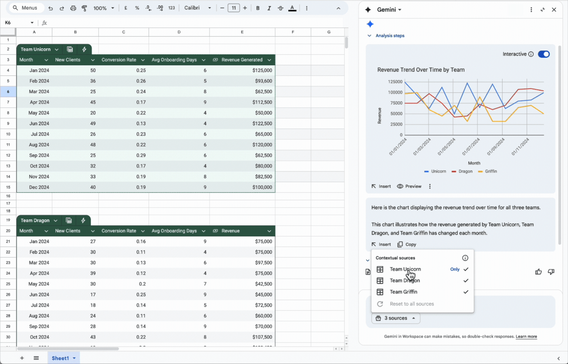
LAB 12 · SCREENSHOT
Choosing Gemini's Sources
Gemini lists the sources it used - and you can limit it to the tabs you choose. Screenshot: Google Docs Editors Help - Collaborate with Gemini in Google Sheets
© Tertiary Infotech Academy Pte Ltd
Gemini for Google Sheet (C817) · C817
105

Slide 107
LAB 12 THEME · OPTIMISATION, REPORTING & SAFE SHARING
Optimise the Hiring Decision and Share Results Safely
LAB 12
The client wants eight hires - two for each of four roles - and one total monthly salary budget of S$41,900. Picking the top two in each role costs S$43,100, which is over budget. You will describe the problem to Gemini's optimisation solver, compare its answer with the no-budget choice, tick the selected candidates and prove the totals with formulas. Then you will export a recommendation to Google Docs, use a Drive file as context, build a minimal Share_View tab and share it safely.
You'll build
OrchidBay_Hiring_Decision with a Selected checkbox column, check formulas that prove the constraints, a recommendation in Google Docs and a separate Share_View file shared view-only
1 Optimise
2 Compare
3 Verify
4 Recommend
5 Share safely
Tools: Google Sheets · Gemini optimisation problem solver · Export to Docs · Drive files as context · sharing · OrchidBay_Hiring_Decision.xlsx
© Tertiary Infotech Academy Pte Ltd
Gemini for Google Sheet (C817) · C817
106

Slide 108
LAB 12 · PROMPTS TO TRY
Sample Prompts — Lab 12
PROMPT
WHAT IT DOES
Optimise: What is the highest total Weighted_Score possible if the budget is reduced by S$2,000?
A sensitivity test: re-run the optimisation with a tighter budget.
1
Optimise: Schedule the eight final interviews across Monday and Tuesday so no interviewer has more than three in a row.
A scheduling problem - another kind of optimisation.
2
Docs: Turn the recommendation into a one-page memo with a table of hires and start dates.
Reformats the recommendation for a client audience.
3
Gmail: Catch me up on the latest emails about the Q3 hiring drive.
Gemini can reference your Gmail (if enabled) - check the Sources it lists.
4
Share: Which tabs in this spreadsheet would be risky to share outside Orchid Bay, and why?
A data-sharing review before you click Share.
5
© Tertiary Infotech Academy Pte Ltd
Gemini for Google Sheet (C817) · C817
107

Slide 109
LAB 12 · VERIFY
Check Your Results — Lab 12
Optimum
CAN-26567, CAN-26608, CAN-26621, CAN-26627, CAN-26683, CAN-26692, CAN-26699, CAN-26711.
Totals
Total score 673.5; total salary S$40,700 (budget S$41,900); Within budget = TRUE.
1
2
Per role
Two Selected per role; All hires = 8.
No-budget comparison
674.5 for S$43,100; swap CAN-26622 -> CAN-26627.
3
4
Share safely
Recommendation exported to Docs; Share_View has 4 columns and 8 candidate rows (plus a header); only the copied Share_View file is shared, as Viewer.
5
© Tertiary Infotech Academy Pte Ltd
Gemini for Google Sheet (C817) · C817
108

Slide 110
TOPIC RECAP
Recap - Interactive Dashboard
LO3 · KPI formulas: Dropdown selectors drive COUNTIFS and AVERAGEIFS KPIs and summary tables.
LO3 · Interactivity: Linked charts, a metric switch, KPI alerts and protection - tested on three views.
1
2
LO3 · Gems: A Candidate Screener Gem with instructions and knowledge files, used from the Sheets side panel.
LO3 · Decide and share: Optimised hires within budget, proved with formulas, exported and shared minimally.
3
4
© Tertiary Infotech Academy Pte Ltd
Gemini for Google Sheet (C817) · C817
109

Slide 111
WRAP-UP
Course Summary & Next Steps
© Tertiary Infotech Academy Pte Ltd
Gemini for Google Sheet (C817) · C817
110

Slide 112
LEARNING OUTCOMES
What You Achieved
Sheets Fundamentals
Use Gemini in Google Sheets - the side panel, actions and formula help - to summarise, quality-check and prepare HR data, and to generate, explain and fix formulas such as VLOOKUP, COUNTIF and nested IF.
Analytics & Visualization
Create colour-coded tables, trackers and dropdowns, extract and categorise text with the AI function, and generate data analysis, insights, pivot tables and charts with Gemini, verifying every result.
1
2
Interactive Dashboard
Build an interactive hiring dashboard, automate repeat screening with a custom Gem, and use Gemini's optimisation solver, reporting and sharing features responsibly.
3
© Tertiary Infotech Academy Pte Ltd
Gemini for Google Sheet (C817) · C817
111

Slide 113
NEXT STEPS
Keep the Verified Workflow
Use Gemini on one real spreadsheet task this week - and check it with a formula.
Turn one monthly report into an interactive dashboard driven by dropdowns.
1
2
Create one Gem for a task you repeat, with fair, evidence-only instructions.
Keep people decisions with accountable people: Gemini drafts, formulas prove, people decide.
3
4
© Tertiary Infotech Academy Pte Ltd
Gemini for Google Sheet (C817) · C817
112

Slide 114
WRAP-UP
Keep Practising After the Course
Re-run the labs on your own machine — repetition is what makes the skills stick.
Apply the techniques to a real process or project in your own organisation.
1
2
Keep your downloaded C817 course files and use the lab checkpoints to restart safely.
Explore the follow-on courses at www.tertiarycourses.com.sg.
3
4
© Tertiary Infotech Academy Pte Ltd
Gemini for Google Sheet (C817) · C817
113

Slide 115
GEMINI FOR GOOGLE SHEET · C817
Thank You!
You can now use Gemini in Google Sheets to clean, analyse and visualise data, build interactive dashboards and reusable Gems - while keeping evidence, privacy and human judgement in control.
© Tertiary Infotech Academy Pte Ltd
Gemini for Google Sheet (C817) · C817
114

